Slide 1
程序的机器级表示（5）
柴云鹏
2021.11

Slide 2
Procedure Call

Slide 3
Outline
Procedure call
Stack frame
Calling conventions
Recursive

Slide 4
Execution within Procedure/Function
Data Movement (e.g., movl $-17, (%esp))
Arithmetic Operations (e.g., incl 8(%eax))
Logical Operations (e.g., xorl 8(%esp), %eax)
Condition Codes (e.g., cmpl %eax, %edx)
Jump Instructions (e.g., jg .L5)
How to execute cross procedures?

Slide 5
Procedure/Function call
Another type of unconditional JUMP
SAME:
Control from one part to another
DIFF:
Return：往返 vs. 单程
Passing data (arguments, return values)
Local variable
Registers：保存离开时的状态

Slide 6
Basic Concept
Terminology
Caller
Callee
f()
call-1
g()
call-2
h()
call-1
Caller: f
Callee: g
call-2
Caller: g
Callee: h

Slide 7
Basic Concept
Terminology
Caller: g
Callee: f
Control Flow
e.g. int g() { return 1 ; }
int f() { return g() ; }
int main() { g(); return f(); }
g()
call
f()
main()
g()
f()
g()

Slide 8
Procedure/Function Implementation
Invoke callee
Return to caller
Passing data
Registers
Local variable

Slide 9
Procedure/Function Implementation
Invoke callee: call (new instructions)
Return to caller
Passing data
Registers
Local variable

Slide 10
Invoke Callee
Instruction
call label (direct)
call *operand (indirect)
Behavior description (by hardware)
Save return address in the stack (call下一条指令)
Jump to the entry of callee
call = push + jmp
push retaddr
jmp callee

Slide 11
Execution of call and ret
//beginning of function sum
08048394 <sum>:
8048394: 55 push %ebp
. . .
80483a4: ret
. . .
//call to sum from main
80483dc: e8 b3 ff ff ff call 8048394<sum>
80483e1: 83 c4 14 add $0x14, %esp
Executing call
After call
%eip | 0x080483dc
%esp | 0xff9bc960
ret | -
%eip | 0x08048394
%esp | 0xff9bc95c
ret | 0x080483e1

Slide 12
Procedure/Function Implementation
Invoke callee: call (new instructions)
Return to caller: ret (new instructions)
Passing data
Registers
Local variable

Slide 13
Return to Caller
Instruction
ret
Behavior description (by hardware)
Pop return address from stack
Jump to return address in caller
ret = pop + jmp
pop retaddr
jmp retaddr

Slide 14
Execution of call and ret
//beginning of function sum
08048394 <sum>:
8048394: 55 push %ebp
. . .
80483a4: ret
. . .
//call to sum from main
80483dc: e8 b3 ff ff ff call 8048394<sum>
80483e1: 83 c4 14 add $0x14, %esp
executing ret
After ret
%eip | 0x080483a4
%esp | 0xff9bc95c
ret | 0x080483e1
%eip | 0x080483e1
%esp | 0xff9bc960
ret | -

Slide 15
Procedure/Function Implementation
Invoke callee: call (new instructions)
Return to caller: ret (new instructions)
Passing data: stack, register
Registers
Local variable

Slide 16
课堂练习
下面的代码片段经常出现在库函数的编译版本中：
call next
next:
popl %eax
Eax被设置成什么值？
解释为什么这个调用没有与之匹配的ret指令
这段代码完成了什么功能？
Notes:
Eax被设置为popl指令的地址
不是真的过程调用
这是IA32中将程序计数器（IP）的值放入通用寄存器的唯一方法（*）

Slide 17
Stack Frame Structure
The portion of stack allocated for a procedure
A stack frame is delimited by
The frame pointer %ebp
The stack pointer %esp
The stack pointer can move when the procedure is executing (dynamic)
The frame pointer is static (%ebp)
%ebp
Frame
%esp

Slide 18
Stack Frame Structure
主函数、子函数共享同一个system stack
call: save return address in the stack
ret: pop return address from stack
The end of caller’s stack frame
Caller Frame
retaddr
%ebp
Callee Frame
%esp

Slide 19
Frame Chain
Pointers (%ebp/%esp) only delimit topmost frame
%ebp
%esp

Slide 20
Frame Chain
Pointers (%ebp/%esp) only delimit topmost frame
Frames are chained
1. call callee
%ebp
%esp

Slide 21
Frame Chain
Pointers (%ebp/%esp) only delimit topmost frame
Frames are chained
1. call callee
callee:
2. push %ebp
3. mov %esp, %ebp
retaddr
%ebp
%esp

Slide 22
Frame Chain
Pointers (%ebp/%esp) only delimit topmost frame
Frames are chained
1. call callee
callee:
2. push %ebp
3. mov %esp, %ebp
retaddr
%ebp
%ebp
%esp

Slide 23
Frame Chain
Pointers (%ebp/%esp) only delimit topmost frame
Frames are chained
1. call callee
callee:
2. push %ebp
3. mov %esp, %ebp
retaddr
old %ebp
%ebp
%esp

Slide 24
Frame Chain
Pointers (%ebp/%esp) only delimit topmost frame
Frames are chained
1. call callee
callee:
2. push %ebp
3. mov %esp, %ebp
. . .
n-2. mov %ebp, %esp
n-1. pop %ebp
n. ret
retaddr
old %ebp
%ebp
%esp

Slide 25
Frame Chain
Pointers (%ebp/%esp) only delimit topmost frame
Frames are chained
1. call callee
callee:
2. push %ebp
3. mov %esp, %ebp
. . .
n-2. mov %ebp, %esp
n-1. pop %ebp
n. ret
retaddr
old %ebp
%ebp
%esp

Slide 26
Frame Chain
Pointers (%ebp/%esp) only delimit topmost frame
Frames are chained
1. call callee
callee:
2. push %ebp
3. mov %esp, %ebp
. . .
n-2. mov %ebp, %esp
n-1. pop %ebp
n. ret
retaddr
old %ebp
%ebp
%esp

Slide 27
Frame Chain
Pointers (%ebp/%esp) only delimit topmost frame
Frames are chained
1. call callee
callee:
2. push %ebp
3. mov %esp, %ebp
. . .
n-2. mov %ebp, %esp
n-1. pop %ebp
n. ret
retaddr
old %ebp
%ebp
%esp

Slide 28
Frame Chain
old %ebp
old %ebp
old %ebp
Pointers (%ebp/%esp) only delimit topmost frame
Frames are chained
%ebp
%esp

Slide 29
Restore Caller %ebp
Instruction
leave
Behavior description (by hardware)
Adjust %esp to callee %ebp
Pop caller %ebp from stack
leave = mov + pop
mov %ebp, %esp
pop %ebp

Slide 30
Execution of call and ret
//beginning of function sum
08048394 <sum>:
8048394: 55 push %ebp
. . .
80483a4: ret
. . .
//call to sum from main
80483dc: e8 b3 ff ff ff call 8048394<sum>
80483e1: 83 c4 14 add $0x14, %esp
Executing call
After call
After ret
%eip | 0x080483dc
%esp | 0xff9bc960
ret | -
%eip | 0x08048394
%esp | 0xff9bc95c
ret | 0x080483e1
%eip | 0x080483e1
%esp | 0xff9bc960
ret | -

Slide 31
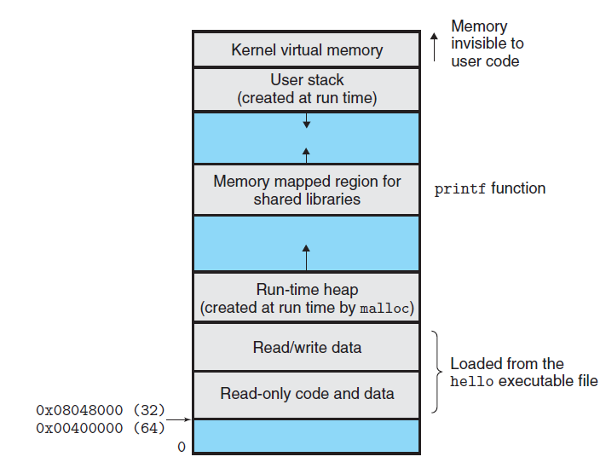
Memory Layout
User stack

Slide 32
Passing Data: Arguments
Pushed by Caller
Saved in caller frame
Just upon of return address
From Nth to 1st (from right to left)
Used by Callee
Relative to %ebp
Offset: 8 + 4*i + %ebp
Caller Frame
argument N
. . . . . .
argument 1
retaddr
old %ebp
%ebp
Callee Frame
%esp

Slide 33
Passing Data: Arguments
%ebp
push argument N
Caller Frame
%esp
argument N

Slide 34
Passing Data: Arguments
%ebp
push argument N
. . .
push argument 1
Caller Frame
argument N
. . . . . .
%esp
argument 1

Slide 35
Passing Data: Arguments
push argument N
. . .
push argument 1
call callee
%ebp
Caller Frame
argument N
. . . . . .
argument 1
%esp
retaddr

Slide 36
Passing Data: Arguments
push argument N
. . .
push argument 1
call callee
push %ebp
%ebp
Caller Frame
argument N
. . . . . .
argument 1
retaddr
%ebp
Callee Frame
%esp

Slide 37
Passing Data: Arguments
push argument N
. . .
push argument 1
call callee
push %ebp
mov %esp, %ebp
. . .
Caller Frame
argument N
. . . . . .
argument 1
retaddr
old %ebp
%esp /
%ebp
Callee Frame

Slide 38
Passing Data: Arguments
X86 64位，传参数先用寄存器
%rdi，%rsi，%rdx，%rcx，%r8，%r9 用作函数参数，依次对应第1参数，第2参数….第6个参数（从左到右）
剩余参数还和以前的算法一样，从右往左依次入栈
例如func(p1, p2, p3, p4, p5, p6, p7, p8)
p1: %rdi, p2: %rsi, p3: %rdx, p4: %rcx, p5: %r8, p6: %r9
栈：(低地址）←ret addr, p7, p8←（高地址）

Slide 39
Passing Data: Return Value
Specific register to keep the return value
%eax / %rax is used to pass the result of callee to caller

Slide 40
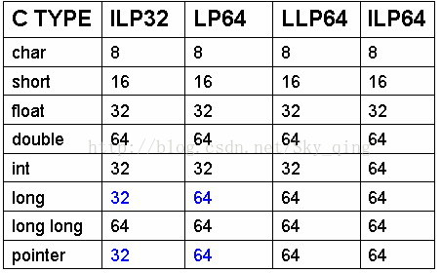
课堂练习
1 incrprob:
addl (%rdx), %edi
movl %edi, (%rdx)
movslq %edi, %rdi
addq %rdi, (%rsi)
ret
求三个参数的顺序和可能的类型，确定incrproc所有可能的函数原型(LP64)。
C函数incrprob有三个参数q,t,x，每个都可能是有符号数，也可能是无符号数，该函数主体为：
*t += x;
*q += *t;
基础知识：
64位汇编传参顺序: rdi, rsi, rdx, rcx, r8, r9
movslq表示把32位数填充进64位数，并做符号扩展
Notes:
(unsigned) int x, (unsigned) long *q, int *t

Slide 41
Procedure/Function Implementation
Invoke callee: call (new instructions)
Return to caller: ret (new instructions)
Passing data: stack, register
Registers: calling convention
Local variable

Slide 42
Calling Convention
Registers act as a single resource shared by all of the procedures
Only 1 procedure can be active
Partition registers between caller and callee (必须遵守惯例)
Caller-save register
Callee-save register
Only consider the registers used by the procedure

Slide 43
Calling Convention
%rbx
%r12
Callee-saved
Temporaries
Callee-save registers
%rbx, %rbp, %r12~%r14
Saved by callee
Caller can use these registers freely
Callee must save them before using
Callee must restore them before return
%r13
%r14
%rbp
Special
%rsp

Slide 44
Callee-save Registers
call callee
push %ebp
mov %esp, %ebp
push %ebx
. . .
retaddr
Old %ebp
%ebp
Callee Frame
%esp
Saved %ebx

Slide 45
Calling Convention
Caller-save registers
所有其他寄存器（除了%rsp不需要保存）
Saved by caller
Callee can use these registers freely
The contents in these registers may be changed after return
Caller must restore them if it tries to use them after calling

Slide 46
Caller-save Registers
push %eax
push argument N
. . .
push argument 1
call callee
%ebp
Caller Frame
Saved %eax
argument N
. . . . . .
argument 1
retaddr
%esp

Slide 47
Procedure/Function Implementation
Invoke callee: call (new instructions)
Return to caller: ret (new instructions)
Passing data: stack, register
Registers: calling convention
Local variable: stack

Slide 48
Local Variable
Why not store local variables in registers ?
No enough registers
Array and structures (e.g., a[2])
Need address (e.g., &a)

Slide 49
Local Variable
Allocation
Below saved regs or old %ebp
move/sub %esp, (e.g., subl $4, %esp)
De-allocation
move/add %esp, (e.g., addl $4, %esp)
Usage
Relative to %esp/%ebp, (e.g., movl %eax, 8(%esp))
retaddr
Old %ebp
%ebp
Callee Frame
Saved regs
Local variable
%esp

Slide 50
Put it Together
%ebp
Caller Frame
%esp

Slide 51
Put it Together
%ebp
Caller Frame
caller-save registers
1. Save caller-save registers (%rbx, %rbp, %r12~15, %rsp以外的寄存器)
%esp

Slide 52
Put it Together
%ebp
Caller Frame
caller-save registers
1. Save caller-save registers
2. Push actual arguments from right to left
arguments (n~1)
%esp

Slide 53
Put it Together
%ebp
Caller Frame
caller-save registers
1. Save caller-save registers
2. Push actual arguments from right to left
3. Call instruction
Save return address
Transfer control to callee
arguments (n~1)
retaddr
%esp

Slide 54
Put it Together
%ebp
Caller Frame
caller-save registers
4. Save caller %ebp
arguments (n~1)
retaddr
%esp
%ebp

Slide 55
Put it Together
Caller Frame
caller-save registers
4. Save caller %ebp
5. Set callee %ebp
arguments (n~1)
retaddr
old %ebp
%esp /
%ebp

Slide 56
Put it Together
Caller Frame
caller-save registers
4. Save caller %ebp
5. Set callee %ebp
6. Save callee-save registers (%rbx, %rbp, %r12~15)
arguments (n~1)
retaddr
%ebp
old %ebp
callee-save registers
%esp

Slide 57
Put it Together
Caller Frame
caller-save registers
4. Save caller %ebp
5. Set callee %ebp
6. Save callee-save registers (%rbx, %rbp, %r12~15)
7. Allocate space for local variable
arguments (n~1)
retaddr
%ebp
old %ebp
callee-save registers
local variables
%esp

Slide 58
Put it Together
Caller Frame
caller-save registers
. . .
n-4. save return value in %eax
arguments (n~1)
retaddr
%ebp
old %ebp
callee-save registers
local variables
%esp

Slide 59
Put it Together
Caller Frame
caller-save registers
. . .
n-4. save return value in %eax
n-3. de-allocate local variable
arguments (n~1)
retaddr
%ebp
old %ebp
callee-save registers
%esp
local variables

Slide 60
Put it Together
Caller Frame
caller-save registers
. . .
n-4. save return value in %eax
n-3. de-allocate local variable
n-2. Restore callee-save registers
arguments (n~1)
retaddr
old %ebp
%esp /
%ebp
callee-save registers
local variables

Slide 61
Put it Together
Caller Frame
%ebp
caller-save registers
. . .
n-4. save return value in %eax
n-3. de-allocate local variable
n-2. Restore callee-save registers
n-1. Restore caller %ebp
arguments (n~1)
retaddr
%esp
old %ebp
callee-save registers
local variables

Slide 62
Put it Together
%ebp
Caller Frame
caller-save registers
. . .
n-4. save return value in %eax
n-3. de-allocate local variable
n-2. Restore callee-save registers
n-1. Restore caller %ebp
n. Ret instruction
pop return address
Transfer control to caller
arguments (n~1)
%esp
retaddr
old %ebp
callee-save registers
local variables

Slide 63
Example
1 int swap_add(int *xp, int *yp)
2 {
3 int x = *xp;
4 int y = *yp;
5
6 *xp = y;
7 *yp = x;
8 return x + y;
9 }
10

Slide 64
Example
11 int caller()
12 {
13 int arg1 = 534;
14 int arg2 = 1057;
15 int sum = swap_add(&arg1, &arg2);
16 int diff = arg1 - arg2;
17
18 return sum * diff;
19 }

Slide 65
Example
Before
int sum = swap_add(&arg1, &arg2);
Stack frame for caller
0 | Saved %ebp
-4 | 1057(arg2)
-8 | 534(arg1)
-12
%ebp
%esp

Slide 66
Parameter Passing
1 leal -4(%ebp),%eax
Compute &arg2
2 pushl %eax
Push &arg2
Stack frame for caller
0 | Saved %ebp
-4 | 1057(arg2)
-8 | 534(arg1)
-12 | &arg2
%ebp
%esp

Slide 67
Parameter Passing
1 leal -4(%ebp),%eax
Compute &arg2
2 pushl %eax
Push &arg2
3 leal -8(%ebp),%eax
Compute &arg1
4 pushl %eax
Push &arg1
Stack frame for caller
0 | Saved %ebp
-4 | 1057(arg2)
-8 | 534(arg1)
-12 | &arg2
-16 | &arg1
%ebp
%esp

Slide 68
Call Instruction
1 leal -4(%ebp),%eax
Compute &arg2
2 pushl %eax
Push &arg2
3 leal -8(%ebp),%eax
Compute &arg1
4 pushl %eax
Push &arg1
5 call swap_add
Call the swap_add function
Stack frame for caller
0 | Saved %ebp
-4 | 1057(arg2)
-8 | 534(arg1)
-12 | &arg2
-16 | &arg1
-20 | Return Addr
%ebp
%esp

Slide 69
Setup code in swap_add
swap_add:
1 pushl %ebp Save old %ebp
Stack frame for caller
0 | Saved %ebp
-4 | 1057(arg2)
-8 | 534(arg1)
-12 | yp(&arg2)
-16 | xp(&arg1)
-20 | Return Addr
-24 | Saved %ebp
%ebp
%esp

Slide 70
Setup code in swap_add
swap_add:
1 pushl %ebp Save old %ebp
2 movl %esp,%ebp
Set %ebp as frame pointer
Stack frame for caller
24 | Saved %ebp
20 | 1057(arg2)
16 | 534(arg1)
12 | yp(&arg2)
8 | xp(&arg1)
4 | Return Addr
0 | Saved %ebp
%ebp
%esp
Stack frame for swap_add

Slide 71
Setup code in swap_add
swap_add:
1 pushl %ebp Save old %ebp
2 movl %esp,%ebp
Set %ebp as frame pointer
3 pushl %ebx
Save %ebx
Stack frame for caller
24 | Saved %ebp
20 | 1057(arg2)
16 | 534(arg1)
12 | yp(&arg2)
8 | xp(&arg1)
4 | Return Addr
0 | Saved %ebp
-4 | Saved %ebx
%ebp
%esp
Stack frame for swap_add

Slide 72
Body code in swap_add
5 movl 8(%ebp),%edx Get xp
Stack frame for caller
24 | Saved %ebp
20 | 1057(arg2)
16 | 534(arg1)
12 | yp(&arg2)
8 | xp(&arg1)
4 | Return Addr
0 | Saved %ebp
-4 | Saved %ebx
%edx
xp(=&arg1=%ebp+16)
%ebp
%esp
Stack frame for swap_add

Slide 73
Body code in swap_add
5 movl 8(%ebp),%edx Get xp
6 movl 12(%ebp),%ecx Get yp
Stack frame for caller
24 | Saved %ebp
20 | 1057(arg2)
16 | 534(arg1)
12 | yp(&arg2)
8 | xp(&arg1)
4 | Return Addr
0 | Saved %ebp
-4 | Saved %ebx
%edx
xp(=&arg1=%ebp+16)
%ebp
%ecx
yp(=&arg2=%ebp+20)
%esp
Stack frame for swap_add

Slide 74
Body code in swap_add
5 movl 8(%ebp),%edx Get xp
6 movl 12(%ebp),%ecx Get yp
7 movl (%edx),%ebx Get x
8 movl (%ecx),%eax Get y
Stack frame for caller
24 | Saved %ebp
20 | 1057(arg2)
16 | 534(arg1)
12 | yp(&arg2)
8 | xp(&arg1)
4 | Return Addr
0 | Saved %ebp
-4 | Saved %ebx
%edx
xp(=&arg1=%ebp+16)
%ebp
%ecx
yp(=&arg2=%ebp+20)
%esp
Stack frame for swap_add
%ebx
534
%eax
1057

Slide 75
Body code in swap_add
9 movl %eax, (%edx) Store y at *xp
Stack frame for caller
24 | Saved %ebp
20 | 1057(arg2)
16 | 1057(arg1)
12 | yp(&arg2)
8 | xp(&arg1)
4 | Return Addr
0 | Saved %ebp
-4 | Saved %ebx
%edx
xp(=&arg1=%ebp+16)
%ebp
%ecx
yp(=&arg2=%ebp+20)
%esp
Stack frame for swap_add
%ebx
534
%eax
1057

Slide 76
Body code in swap_add
9 movl %eax, (%edx) Store y at *xp
10 movl %ebx, (%ecx) Store x at *yp
Stack frame for caller
24 | Saved %ebp
20 | 534(arg2)
16 | 1057(arg1)
12 | yp(&arg2)
8 | xp(&arg1)
4 | Return Addr
0 | Saved %ebp
-4 | Saved %ebx
%edx
xp(=&arg1=%ebp+16)
%ebp
%ecx
yp(=&arg2=%ebp+20)
%esp
Stack frame for swap_add
%ebx
534
%eax
1057

Slide 77
Body code in swap_add
9 movl %eax, (%edx) Store y at *xp
10 movl %ebx, (%ecx) Store x at *yp
11 addl %ebx,%eax Set return value = x+y
Stack frame for caller
24 | Saved %ebp
20 | 534(arg2)
16 | 1057(arg1)
12 | yp(&arg2)
8 | xp(&arg1)
4 | Return Addr
0 | Saved %ebp
-4 | Saved %ebx
%edx
xp(=&arg1=%ebp+16)
%ebp
%ecx
yp(=&arg2=%ebp+20)
%esp
Stack frame for swap_add
%ebx
534
%eax
1591

Slide 78
Finishing code in swap_add
12 popl %ebx Restore %ebx
Stack frame for caller
24 | Saved %ebp
20 | 534(arg2)
16 | 1057(arg1)
12 | yp(&arg2)
8 | xp(&arg1)
4 | Return Addr
0 | Saved %ebp
-4 | Saved %ebx
%edx
xp(=&arg1=%ebp+16)
%ebp
%ecx
yp(=&arg2=%ebp+20)
%esp
Stack frame for swap_add
%ebx
original value
%eax
1591

Slide 79
Finishing code in swap_add
12 popl %ebx Restore %ebx
13 movl %ebp, %esp Restore %esp
Stack frame for caller
24 | Saved %ebp
20 | 534(arg2)
16 | 1057(arg1)
12 | yp(&arg2)
8 | xp(&arg1)
4 | Return Addr
0 | Saved %ebp
-4 | Saved %ebx
%edx
xp(=&arg1=%ebp+16)
%ebp
%ecx
yp(=&arg2=%ebp+20)
%esp
Stack frame for swap_add
%ebx
original value
%eax
1591

Slide 80
Finishing code in swap_add
12 popl %ebx Restore %ebx
13 movl %ebp, %esp Restore %esp
14 popl %ebp Restore %ebp
Stack frame for caller
0 | Saved %ebp
-4 | 534(arg2)
-8 | 1057(arg1)
-12 | yp(&arg2)
-16 | xp(&arg1)
-20 | Return Addr
 | Saved %ebp
 | Saved %ebx
%ebp
%esp
%edx
xp(=&arg1=%ebp+16)
%ecx
yp(=&arg2=%ebp+20)
%ebx
original value
%eax
1591

Slide 81
Finishing code in swap_add
12 popl %ebx Restore %ebx
13 movl %ebp, %esp Restore %esp
14 popl %ebp Restore %ebp
15 ret Return to caller
Call by value
Stack frame for caller
0 | Saved %ebp
-4 | 534(arg2)
-8 | 1057(arg1)
-12 | yp(&arg2)
-16 | xp(&arg1)
-20 | Return Addr
 | Saved %ebp
 | Saved %ebx
%ebp
%esp
%edx
xp(=&arg1=%ebp+16)
%ecx
yp(=&arg2=%ebp+20)
%ebx
original value
%eax
1591

Slide 82
int proc(void) {
int x, y;
scanf(“%x %x”, &y, &x);
return x-y;
}
GCC产生如下汇编代码
1 proc
Pushl %ebp
Movl %esp, %ebp
Subl $40, %esp
Leal -4(%ebp), %eax
Movl %eax, 8(%esp)
Leal -8(%ebp), %eax
Movl %eax, 4(%esp)
Movl $.LCO, (%esp) ; 常量字符串“%x %x”的地址
Call scanf
Movl -4(%ebp), %eax
12 Subl -8(%ebp), %eax
13 Movl %ebp, %esp,
14 Popl %ebp
15 Ret
过程proc开始时，esp值为0x800040, ebp值为0x00060，scanf输入值为0x46和0x53, “%x %x”地址为0x300070.
第3行ebp的值被设为多少？
第4行esp的值被设为多少？
局部变量x和y的地址是多少？
画出scanf返回后的栈图
指出proc函数未使用的栈区的地址
Notes:
A. 0x80003c; B. 0x800014; C. x:0x800038, y: 0x800034; E. 0x800020~0x800033

Slide 83
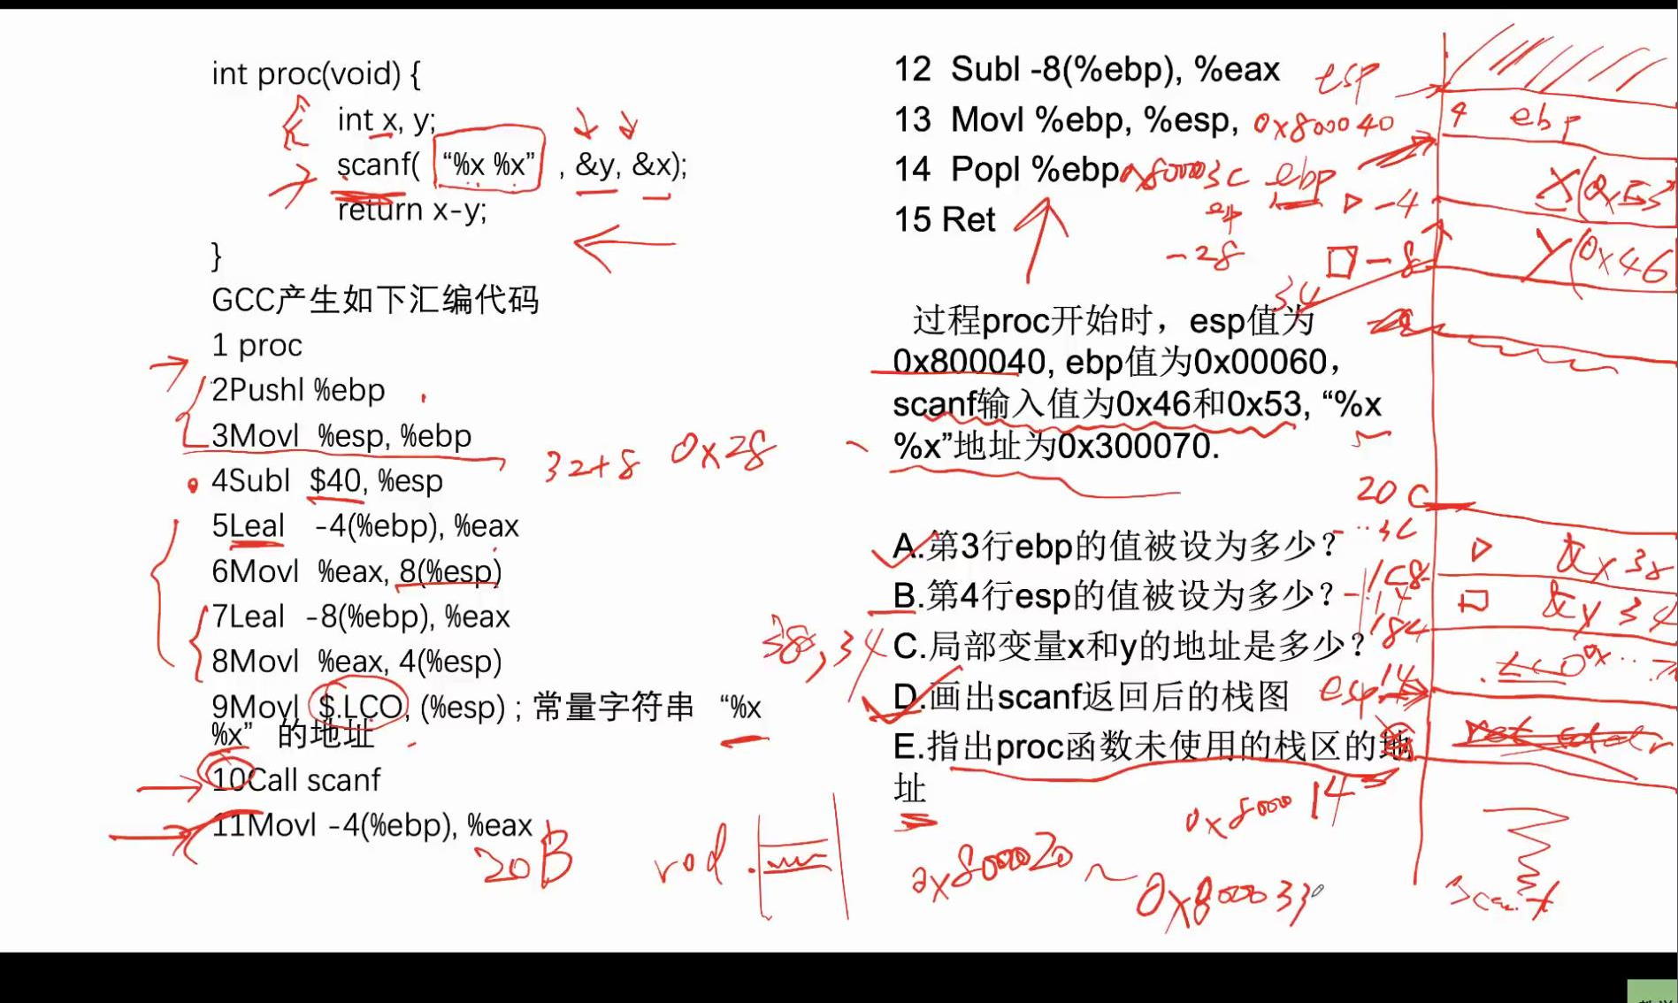

Slide 84
Recursive Function
pcount_r:
movl $0, %eax
testq %rdi, %rdi
je .L6
pushq %rbx
movq %rdi, %rbx
andl $1, %ebx
shrq %rdi
call pcount_r
addq %rbx, %rax
popq %rbx
.L6:
rep; ret
/* Recursive popcount */
long pcount_r(unsigned long x) {
if (x == 0)
return 0;
else
return (x & 1)
+ pcount_r(x >> 1);
}
Notes:
rep; ret: AMD的分支预测器中存在一个问题，即单字节ret紧跟在您引用的代码（以及其他一些情况）中的条件跳转之后，并且解决方法是添加rep前缀，CPU会忽略该前缀，但是修正预测变量。

Slide 85
Recursive Function Terminal Case
/* Recursive popcount */
long pcount_r(unsigned long x) {
if (x == 0)
return 0;
else
return (x & 1)
+ pcount_r(x >> 1);
}
pcount_r:
movl $0, %eax
testq %rdi, %rdi
je .L6
pushq %rbx
movq %rdi, %rbx
andl $1, %ebx
shrq %rdi
call pcount_r
addq %rbx, %rax
popq %rbx
.L6:
rep; ret
Register | Use(s) | Type
%rdi | x | Argument
%rax | Return value | Return value

Slide 86
Recursive Function Register Save
pcount_r:
movl $0, %eax
testq %rdi, %rdi
je .L6
pushq %rbx
movq %rdi, %rbx
andl $1, %ebx
shrq %rdi
call pcount_r
addq %rbx, %rax
popq %rbx
.L6:
rep; ret
/* Recursive popcount */
long pcount_r(unsigned long x) {
if (x == 0)
return 0;
else
return (x & 1)
+ pcount_r(x >> 1);
}
Register | Use(s) | Type
%rdi | x | Argument
. . .
Rtn address
Saved %rbx
%rsp

Slide 87
Recursive Function Call Setup
/* Recursive popcount */
long pcount_r(unsigned long x) {
if (x == 0)
return 0;
else
return (x & 1)
+ pcount_r(x >> 1);
}
pcount_r:
movl $0, %eax
testq %rdi, %rdi
je .L6
pushq %rbx
movq %rdi, %rbx
andl $1, %ebx
shrq %rdi
call pcount_r
addq %rbx, %rax
popq %rbx
.L6:
rep; ret
Register | Use(s) | Type
%rdi | x >> 1 | Rec. argument
%rbx | x & 1 | Callee-saved

Slide 88
Recursive Function Call
/* Recursive popcount */
long pcount_r(unsigned long x) {
if (x == 0)
return 0;
else
return (x & 1)
+ pcount_r(x >> 1);
}
pcount_r:
movl $0, %eax
testq %rdi, %rdi
je .L6
pushq %rbx
movq %rdi, %rbx
andl $1, %ebx
shrq %rdi
call pcount_r
addq %rbx, %rax
popq %rbx
.L6:
rep; ret
Register | Use(s) | Type
%rbx | x & 1 | Callee-saved
%rax | Recursive call return value

Slide 89
Recursive Function Result
/* Recursive popcount */
long pcount_r(unsigned long x) {
if (x == 0)
return 0;
else
return (x & 1)
+ pcount_r(x >> 1);
}
pcount_r:
movl $0, %eax
testq %rdi, %rdi
je .L6
pushq %rbx
movq %rdi, %rbx
andl $1, %ebx
shrq %rdi
call pcount_r
addq %rbx, %rax
popq %rbx
.L6:
rep; ret
Register | Use(s) | Type
%rbx | x & 1 | Callee-saved
%rax | Return value

Slide 90
Recursive Function Completion
pcount_r:
movl $0, %eax
testq %rdi, %rdi
je .L6
pushq %rbx
movq %rdi, %rbx
andl $1, %ebx
shrq %rdi
call pcount_r
addq %rbx, %rax
popq %rbx
.L6:
rep; ret
/* Recursive popcount */
long pcount_r(unsigned long x) {
if (x == 0)
return 0;
else
return (x & 1)
+ pcount_r(x >> 1);
}
Register | Use(s) | Type
%rax | Return value | Return value
. . .
%rsp
Notes:
在两种条件下无法发挥cpu的分支预测功能： 1> 一个分支，里面带有near-return（opcode C3h），例如 label： ret 2> 一个判断条件紧跟着就是near-return，例如 jle label2 ret
为了使得代码还是能够用得上cpu的分支预测（branch prediction），最简单的解决办法就是在ret前面插入rep，这称之为two-byte ret，使得性能可以提高。

Slide 91
课堂练习
一个具有通用结构的C函数如下：
long rfun (unsigned long x) {
if ( ______________ )
return ___________;
unsigned long nx =________;
long rv = rfun(nx);
return _____________;
}
请填写C语言代码中缺失的表达式；rfun存储在被调用者保存寄存器%rbx中的值是_________。
GCC产生的汇编代码如下：
long rfun (unsigned long x)
x in %rdi
rfun:
pushq %rbx
movq %rdi, %rbx
movl $0, %eax
testq %rdi, %rdi
je .L2
shrq $2, $rdi
call rfun
addq %rbx, %rax
.L2
popq %rbx
ret
Notes:
If (X == 0) return x;
Unsigned long nx = x/4
Long rv = rfun(nx);
Return rv+x;
%rbx中的值是传入函数的参数x

Slide 92
课堂练习（课后）
斐波那契数列公式
F(0)=0, F(1)=1,
F(n)=F(n-1)+F(n-2)
请写出汇编函数求解斐波那契数列的第n项，然后画出主函数调用F(4) 的过程中，栈的状态（要求标注每个位置所有出现过的值）
假设32位机，函数调用过程使用栈进行传参，函数F()求解过程中只保存了ebp的值，没有用到局部变量。
在图中画出Stack Frame Chain
Notes:
F(4) -> F(3) + F(2)
F(3) -> F(2) + F(1)
-> F(1) + F(0) + F(1)
F(2) -> F(1) + F(0)
4, 3, 2, 1/0
1,
2, 1/0

Slide 93
Homework8
11月25日提交

